Slide 1



Azure Stack in
Proactive Tech
SAMPATH KUMAR BINGI
December 8, 2017

Slide 2
Why Cloud ???
Why Cloud ???
Real time challenges in On-premise services ?
Typical usage of compute?
Notes:
Cloud computing is the delivery of computing services over the internet
Such as Virtual machines, storage, online software, databases, networking, etc..

Slide 3
Cloud Fundamentals
Infrastructure as a Service (IaaS):
basic compute and storage resources
On-demand servers
Amazon EC2, VMWare ,vCloud
Platform as a Service (PaaS):
cloud application infrastructure
On-demand application-hosting environment
E.g. Salesforce.com, Microsoft Azure, Amazon
Software as a Service (SaaS):
cloud applications
On-demand applications
E.g. Office 365, GMail, Microsoft Office Web Companions
Notes:
P37 – divide into 2 slides

Slide 4
What is Microsoft Azure
Azure is an OS for the data center
Handles resource management, provisioning, and monitoring
Manages application lifecycle
Allows developers to concentrate on business logic
Provides common building blocks for distributed applications
Reliable queuing, simple structured storage, SQL storage
Application services like access control, caching, and connectivity
Design For Failure
Scale out for capacity and redundancy
High Availability and Short time outs with retries
Stateless with durable external storage
Notes:
P37 – divide into 2 slides

Slide 5
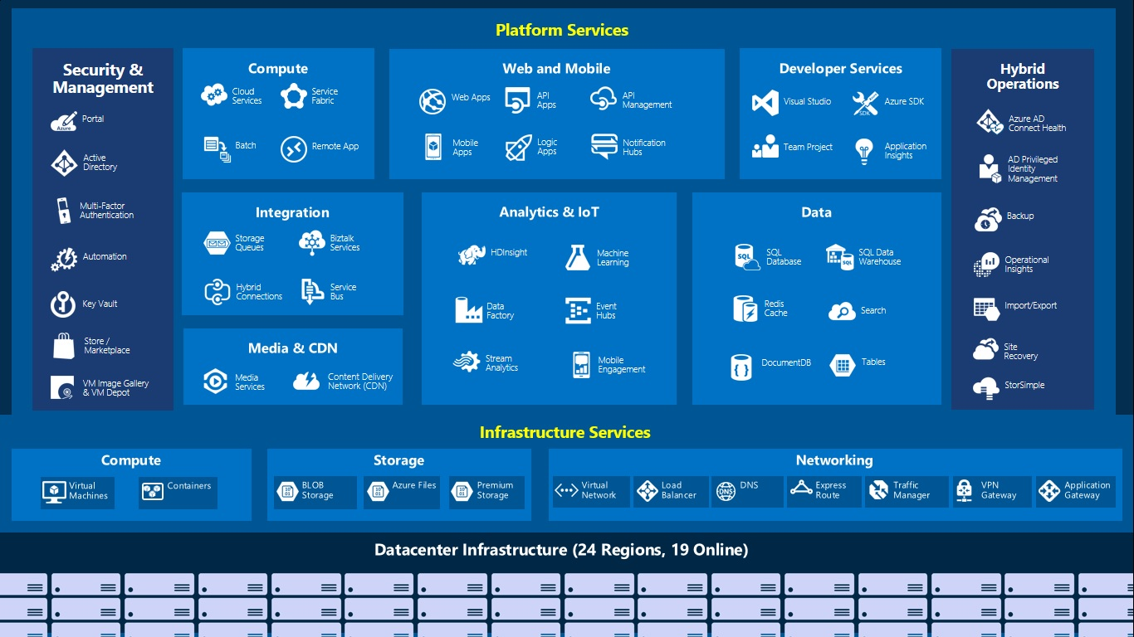
Azure Building Blocks

Slide 6
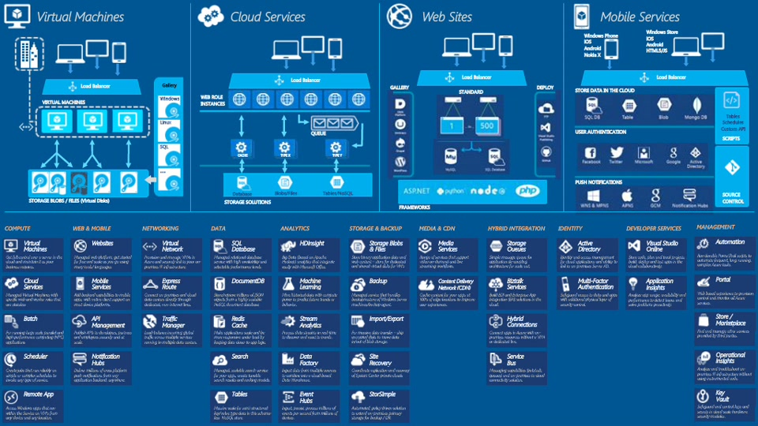
Azure Layered View

Slide 7
Services Used
Cloud services
Virtual machines
App services (Web jobs)
SQL Azure
Blob storage and table storage
Azure Search
Service bus
Cognitive service
Batch account
Redis Cache
CDN profiles
Application Insights
New Relic
Notes:
P37 – divide into 2 slides

Slide 8
Azure – Cloud Service
Cloud Application Typically made up of different components
Front end: e.g. load-balanced stateless web servers
Middle worker tier: e.g. File processing, encoding or any backend process ..
Backend storage: e.g. SQL tables ,storage or files
Multiple instances of each for scalability and availability
Azure Cloud Service specification
Definition information
Configuration information
At least one “role”
Roles are like DLLs in the service “process”
Collection of code with an entry point that runs in its own virtual machine
Notes:
P37 – divide into 2 slides

Slide 9
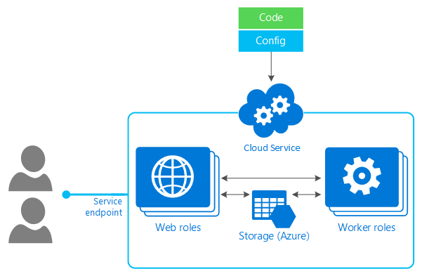
Azure – Cloud Service

Slide 10
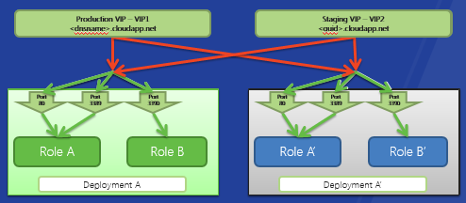
Cloud Service – Slots
2 deployment slots
Production: updating a live service
Staging: for testing first
Notes:
P37 – divide into 2 slides

Slide 11
Azure Storage
Type of Storages
Blob - Provide a simple interface for storing named files along with metadata for the file
Table - Provide lightly structured storage with a set of entities that contain a set of properties
Queues - Provide reliable storage and delivery of messages
Storage Characteristics
Scalable (capacity)
Highly available
Simple and familiar programming interfaces
REST (HTTP and HTTPS)
.NET accessible
Developer Tools
Azure Storage Explorer
Visual Studio
Cloud Berry for Azure Blob storage
Lot other third party tools ….
Notes:
P37 – divide into 2 slides

Slide 12
Azure Storage Logical View
Container
Blobs
http://<account>.blob.core.windows.net/<container>
Storage Account
Table
Entities
http://<account>.table.core.windows.net/<table>
Queue
Messages
http://<account>.queue.core.windows.net/<queue>
Notes:
P37 – divide into 2 slides

Slide 13
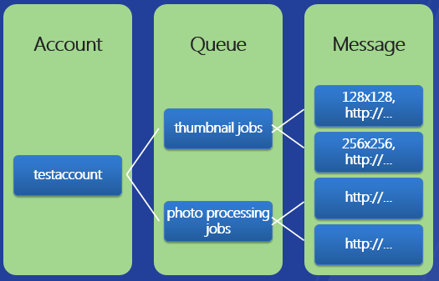
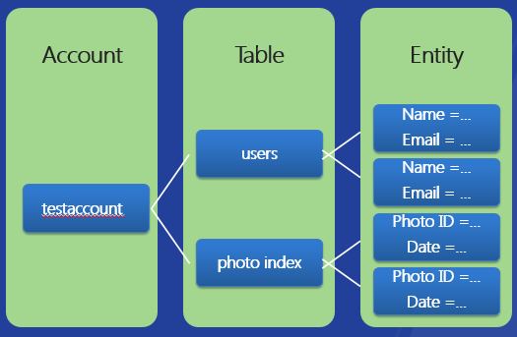
Azure Storage - Table
Table Storage
An account can create many tables
Can read/write using .Net Classes and Linq
A table is set of entities(row)
An entity is set of properties (columns)
Can manage billions of entities and TB’s of data
Two “key” properties that together are the unique ID of the entity in the table
PartitionKey – enables scalability
RowKey – uniquely identifies the entity within the partition
Logical View
Queue
Provide reliable message delivery
Simple, asynchronous work dispatch
Programming semantics ensure that a message can be processed at least once
Queues are highly available, durable and performance efficient
Maximum size is 64K
FIFO in general, but not guaranteed
Logical View
Notes:
P37 – divide into 2 slides

Slide 14
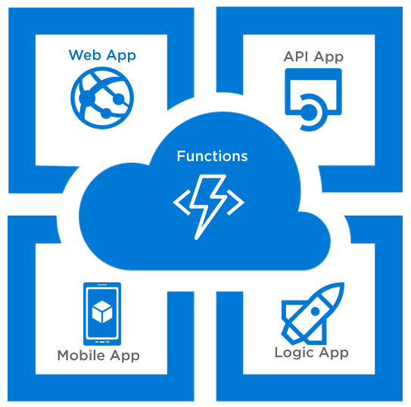
Azure – App Services
What is App Service
App Service is a platform-as-a-service offering of Microsoft Azure.
Create web and mobile apps for any platform or device.
Integrate your apps with SaaS solutions,
connect with on-premises applications, and automate your business processes.
It also includes new capabilities for automating business processes and hosting cloud APIs.
App types in App Service
Web Apps
Mobile Apps
Api Apps
Logic Apps
Function Apps
Notes:
P37 – divide into 2 slides

Slide 15
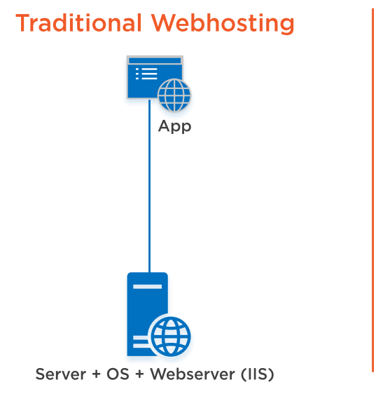
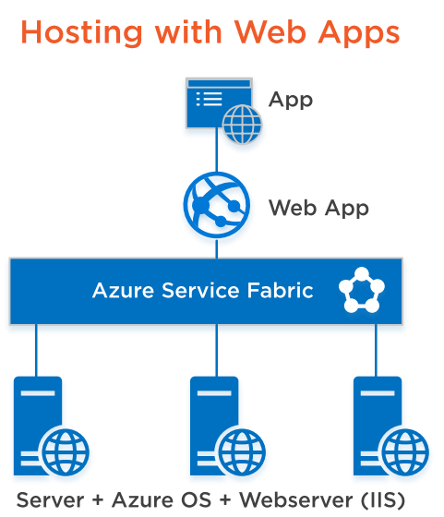
What are Web Apps ?

Slide 16
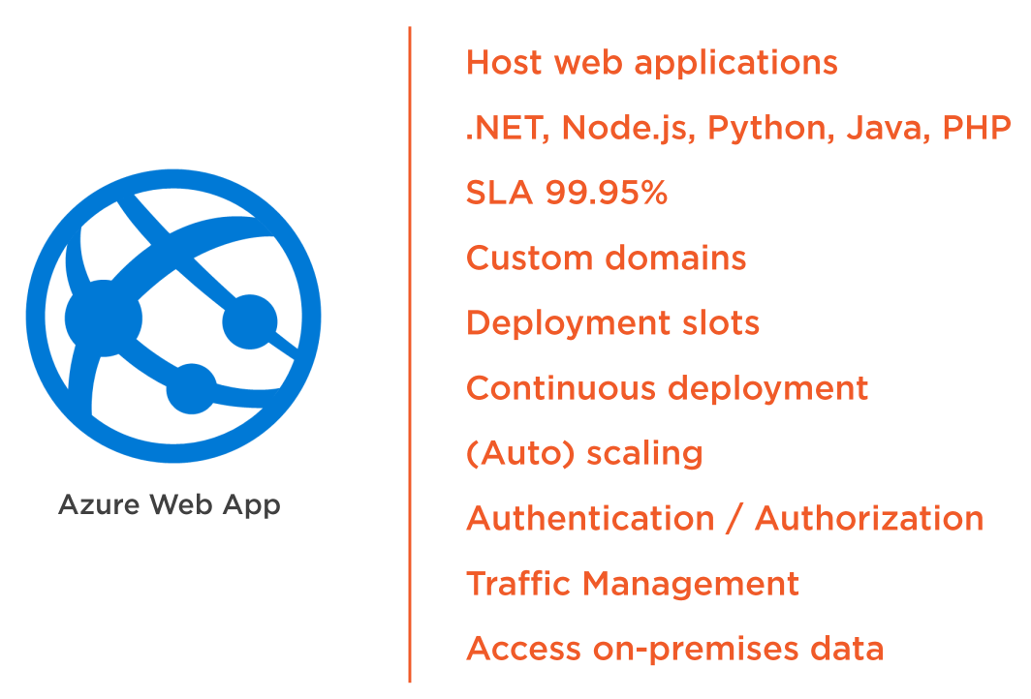
App Service – Web Apps
Notes:
P37 – divide into 2 slides

Slide 17
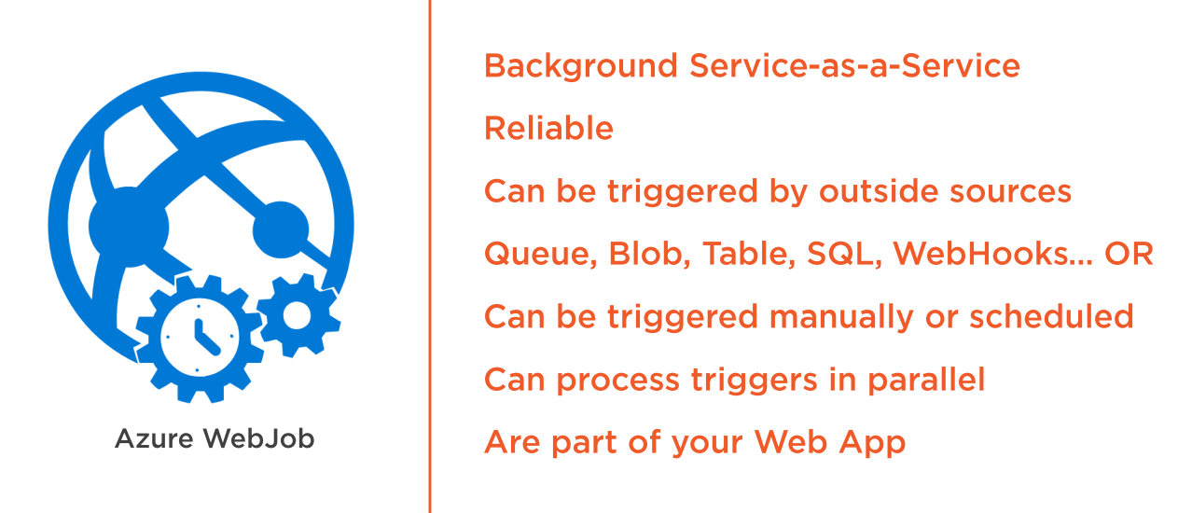
App Service – Web Jobs

Slide 18
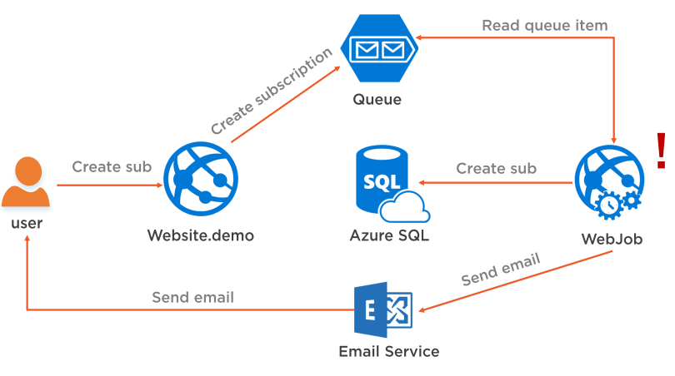
Typical Work flow

Slide 19
SQL Azure
Applications that need elastic scale and/or reduced overhead
Customers does not want to add additional IT resources for support and maintenance
Scale up to thousands of DBs, process TBs and then scale down when not needed
Audit logs, Threat and anomaly detection

Slide 20


SQL Azure
SQL Azure Family
Database
Reporting
Sync
Advanced features
Demo
reporting
data sync
database
Notes:
P37 – divide into 2 slides

Slide 21
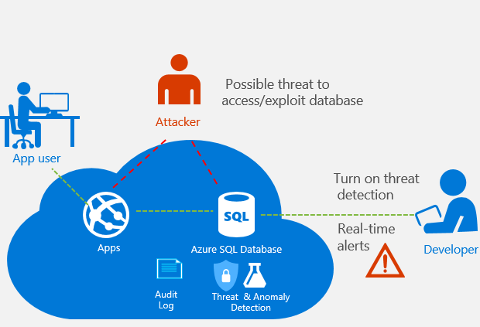
SQL Azure - Security

Slide 22
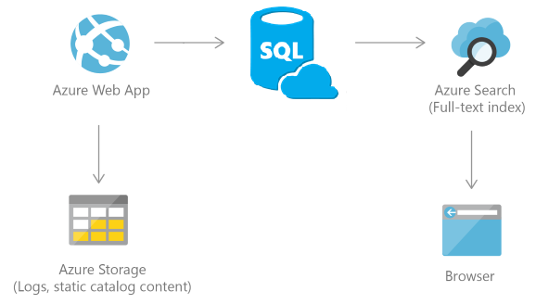
Azure Search
Fully manages hosted cloud search service
Functionality is exposed through REST API or .NET SDK libraries
Index based search

Slide 23
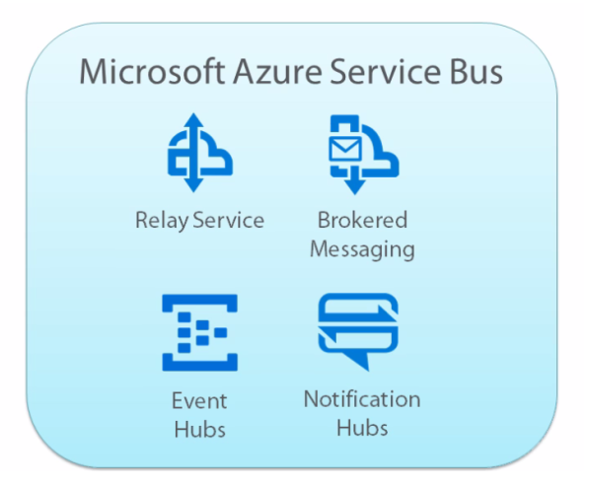
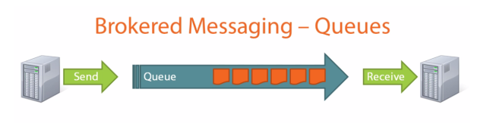
Azure Service Bus
Service Bus is a PaaS Cloud computing service.
Relay Service
Brokered messaging
Event Hubs
Notification Hubs

Slide 24
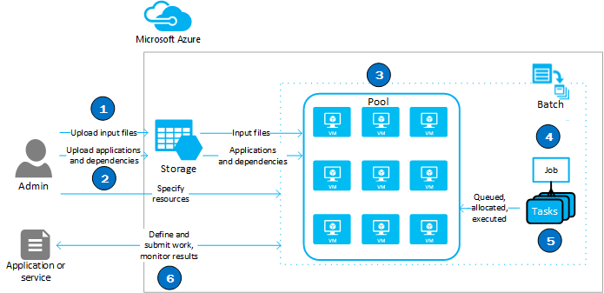
Azure Batch Service
Batch service helps in processing highly parallelizable algorithms
A single job can be broken into multiple tasks
Each task will execute/run in a task virtual machine (TVM)

Slide 25
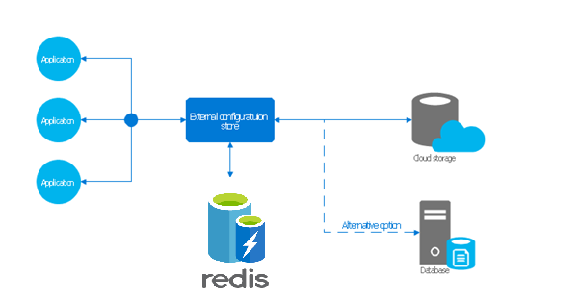
Azure Redis Cache
A secure data and messaging broker that provides high throughput and low-latency access to data for applications

Slide 26
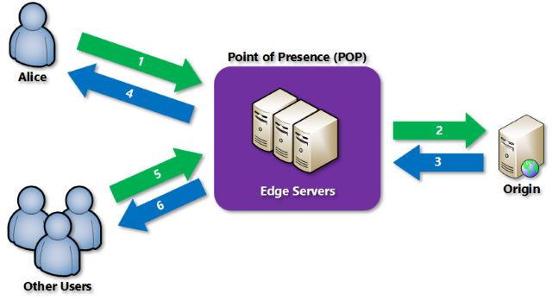
Azure CDN profiles
Azure Content Delivery Network (CDN) caches static web content at strategically placed locations to provide maximum throughput for securely delivering content to users.
Better performance and improved user experience for end users
Large scaling to better handling instantaneous high loads

Slide 27
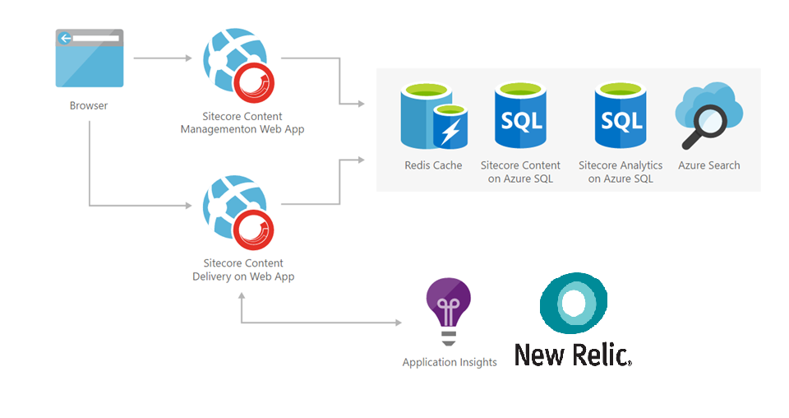
Application Insights and New Relic
Application Insights and New Relic is an extensible application performance management service for web developers
This provides a powerful analytics tool to help developer diagnose issue
You can monitor your live sitecore applications
It will automatically detect performance anomalies

Slide 28
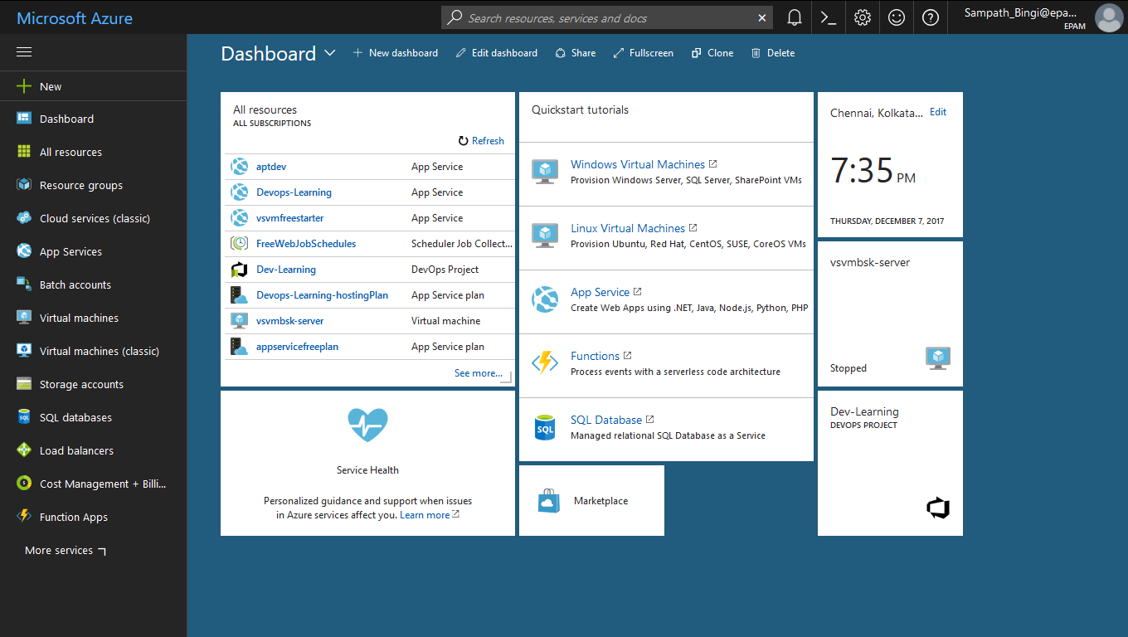
Azure Portal - Overview
Notes:
P37 – divide into 2 slides

Slide 29
Questions ??
Notes:
P37 – divide into 2 slides

Slide 30
Thank you

